Slide 1
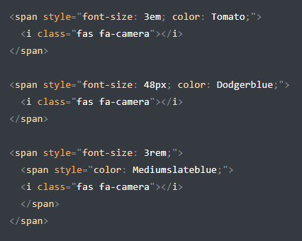
COLOR Y TAMAÑO PARA ICONOS

Slide 2
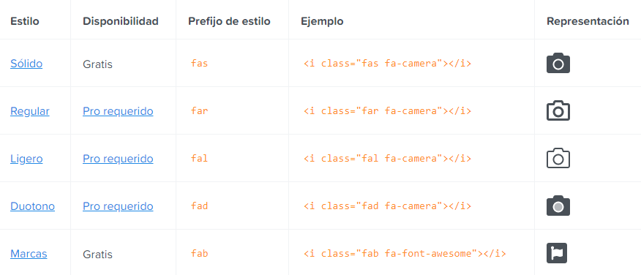

Slide 3
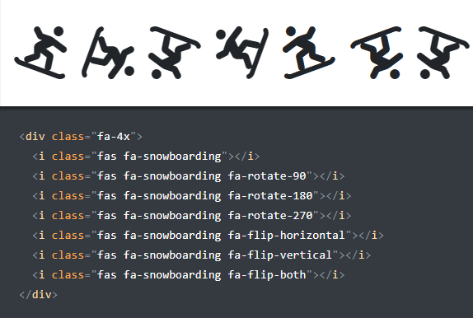
ROTACION DE ICONOS

Slide 4
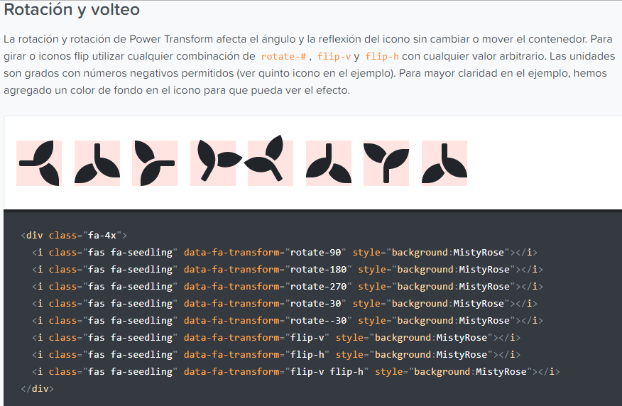

Slide 5
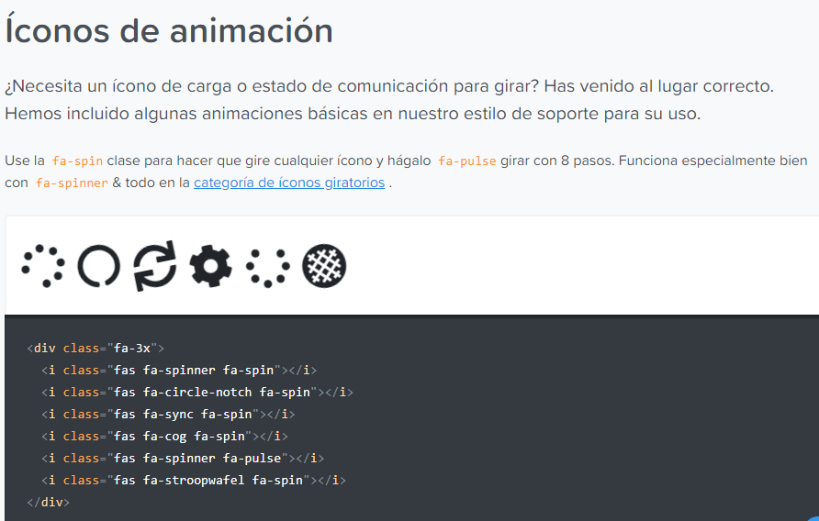

Slide 6
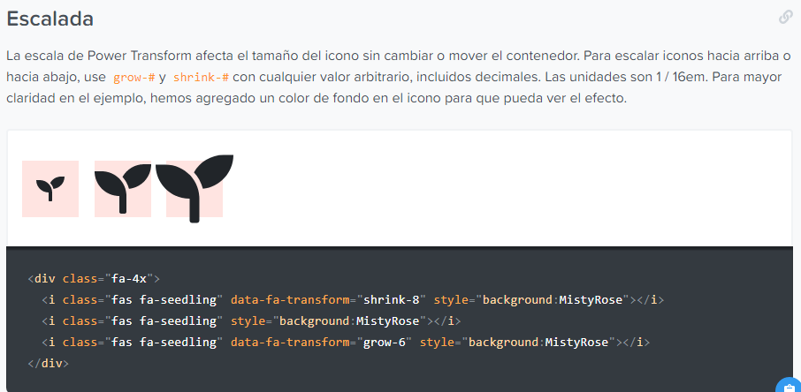
MOVER ICONOS HACIA ARRIBA O HACIA ABAJO :

Slide 7
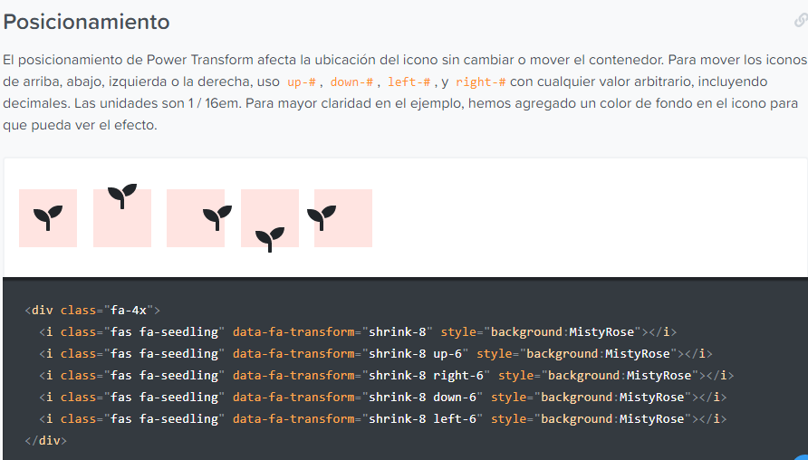

Slide 8
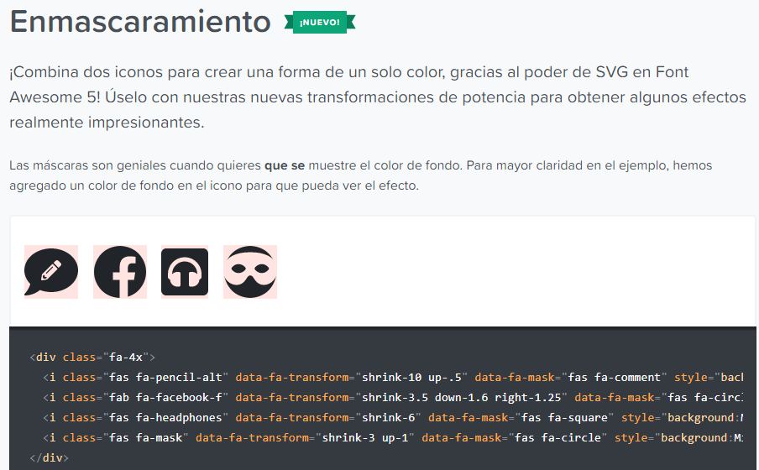

Slide 9
<div class="fa-4x">
<i class="fas fa-pencil-alt" data-fa-transform="shrink-10 up-.5" data-fa-mask="fas fa-comment" style="background:MistyRose"></i>
<i class="fab fa-facebook-f" data-fa-transform="shrink-3.5 down-1.6 right-1.25" data-fa-mask="fas fa-circle" style="background:MistyRose"></i>
<i class="fas fa-headphones" data-fa-transform="shrink-6" data-fa-mask="fas fa-square" style="background:MistyRose"></i>
<i class="fas fa-mask" data-fa-transform="shrink-3 up-1" data-fa-mask="fas fa-circle" style="background:MistyRose"></i>
</div>

Slide 10
https://fontawesome.com/how-to-use/on-the-web/styling/layering

